Slide 1
Analysis of the US Mobile Phones Market
Notes:
Objective

Slide 2
AGENDA
Objective
Background
Key findings
Recommendations
Appendix:
Data sources
Data methodology
Data model assumptions
Notes:
Objective

Slide 3
BACKGROUND
China, India and the US are the countries with the highest number of smartphone users, and together, they contribute to about 50% of the global smartphone user base.
In order to help a new entrant in the mobile phones market of the US, you need to analyse the US market data based on the customer reviews given on the Amazon website to get an understanding of the competitor performance and user preferences.
Notes:
Objective

Slide 4
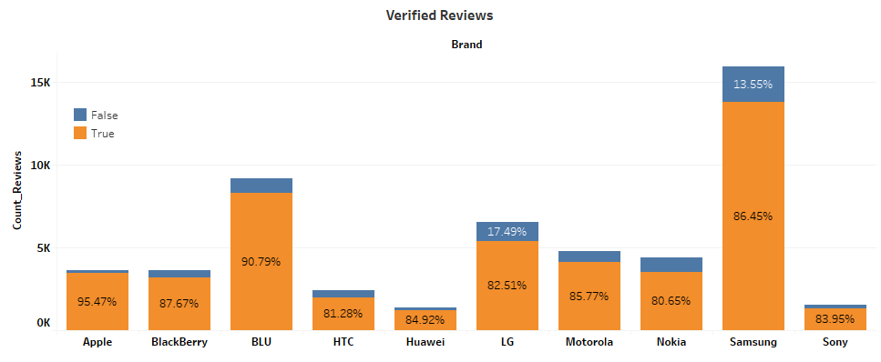
REVIEWS SHOW THE TRUE PICTURE OF THE MARKET
On an average, around 85% of the reviews are given by verified users and not paid/bot generated reviews.
Notes:
Objective

Slide 5
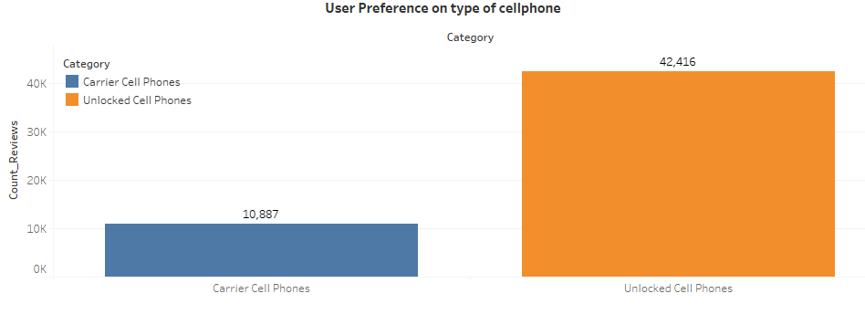
UNLOCKED CELL PHONES PREFERED OVER CARRIER CELL PHONES
Carrier phones are four times less popular as compared to the Unlocked phones
The lower popularity of carrier cell phones signifies that customers want more flexibility when it comes to phone operators
Notes:
Objective

Slide 6
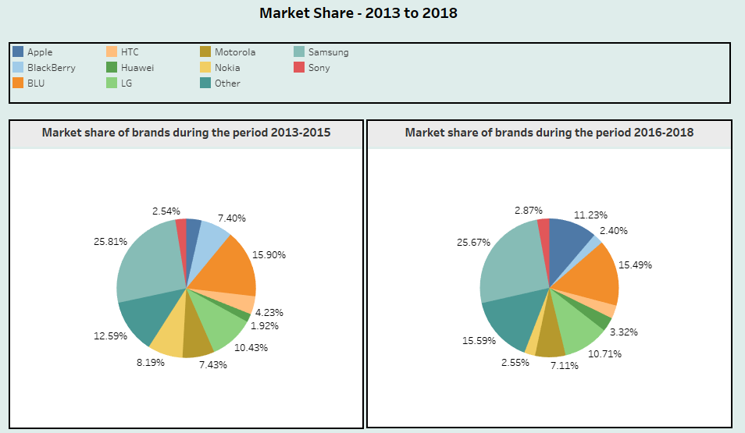
SAMSUNG, BLU AND HUAWEI: TOP-THREE PLAYERS IN THE MARKET IN 2013–2018
Samsung has the highest market share. The market share of Nokia and Blackberry decreased by two-third during 2016-2018 as compared to 2015-2015
Apple gained (~7%) significant market share during 2016-2018.
Notes:
Objective

Slide 7
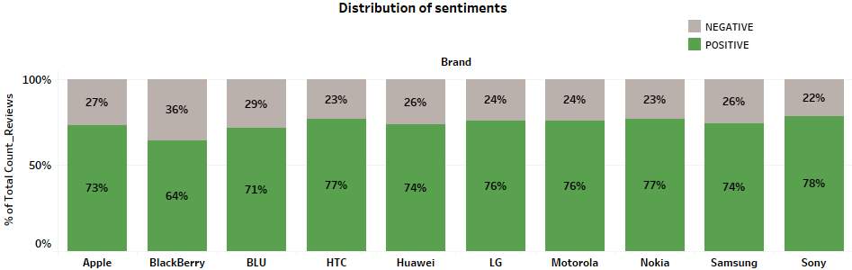
DISTRIBUTION OF POSITIVE - NEGATIVE SENTIMENTS
The percentage of positive reviews hovers around 75% for most brands, except for Blackberry, which has the highest percentage of negative reviews.
Notes:
Objective

Slide 8
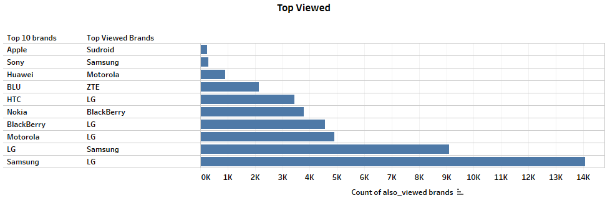
MAJOR COMPETITORS FOR THE TOP 10 BRANDS
Although Apple's market share is 1/8th of Samsung's, the number of people who look for other phones before buying an Apple phone is around 1/28th times that of Samsung’s, which indicates Apple has high customer loyalty.
Samsung and LG mostly act as the substitutes of each other.
Notes:
Objective

Slide 9
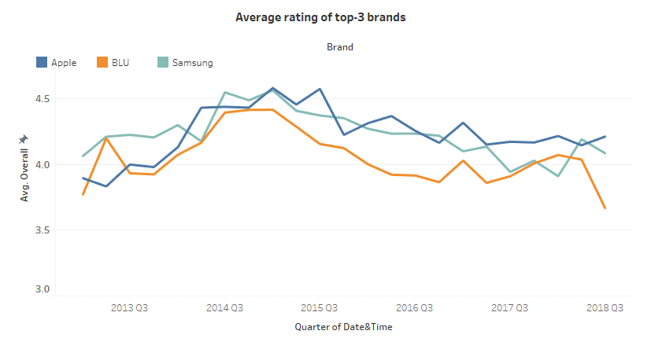
APPLE HAS CONSISTENTLY HIGHER RATING
Apple has received consistently high rating since 2017 as compared to its competitors Samsung and BLU.
The average rating of BLU started declining from 2018.
Notes:
Objective

Slide 10
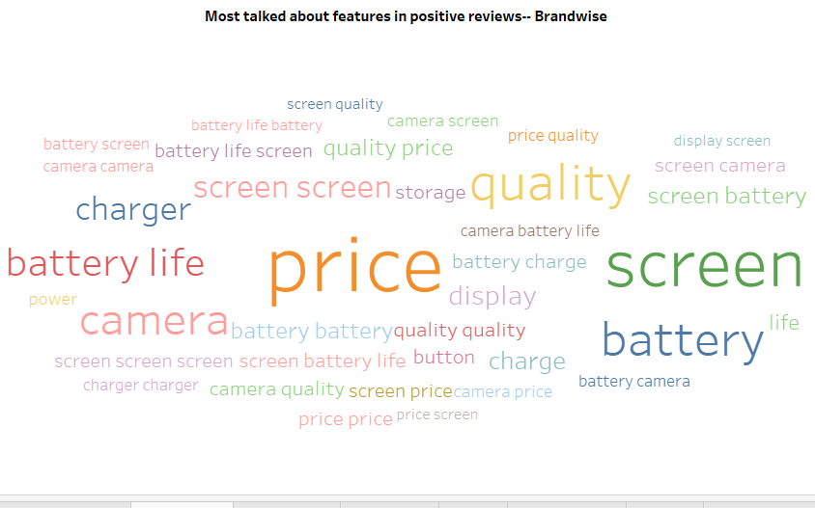
PRICE: THE BIGGEST CONCERN FOR CUSTOMERS
Pricing followed by screen, camera and battery plays an important role in generating positive sentiment among customers.
Notes:
Objective

Slide 11
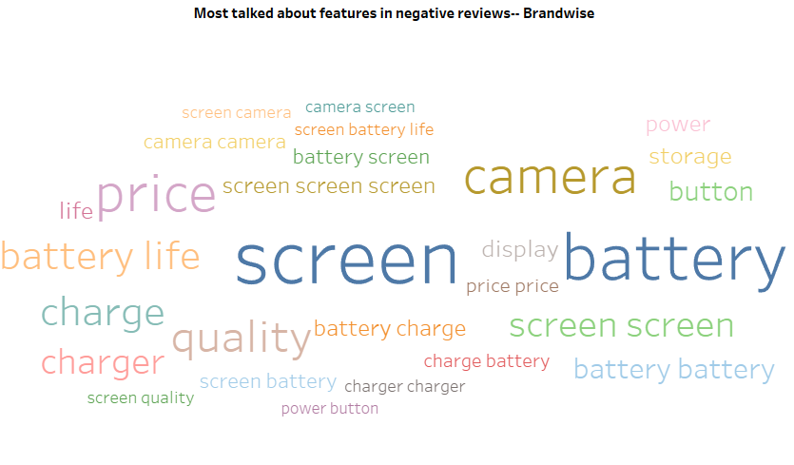
SCREEN : THE BIGGEST CONCERN FOR CUSTOMERS
The new entrant in the market should focus more on the screen and battery quality as these seem to affect the customer sentiment.
Notes:
Objective

Slide 12
RECOMMENDATIONS
The major competitors in the market are Samsung, Apple and BLU.
Pricing is an important strategy needed to gain market share.
Screen and battery quality for the given price is an important factor in deciding the customer sentiment.
Apple has got better brand loyalty compared to its competitors. Apple’s strategy and design need to be explored for further insights.
Production should be such that it can satisfy the demand for unlocked phones and, thus, a higher production of Unlocked phones is necessary than Carrier phones.
Notes:
Objective

Slide 13
APPENDIX - DATA SOURCES
Here is a snapshot of our data dictionary:
Phone data as the .csv file: Contains consumer activity information such as overall rating, review text and reviewer ID.
Phone metadata as zipped .json file: It contains the product information and is independent of the consumer/reviewer activity and includes description, price, sales-rank, brand info, co-purchasing links, etc.
Notes:
Objective

Slide 14
APPENDIX - DATA METHODOLOGY
We conducted a thorough analysis of the data on the Amazon review data. The process included:
Cleaning the data
Merging metadata and phone data
Text cleaning and extracting features
Creating visualisations in Tableau
Notes:
Objective

Slide 15
APPENDIX - DATA ASSUMPTIONS
Certain gaps were observed due to data unavailability and dated information:
Market share of a brand is directly proportional to the number of reviews present for that particular brand in the dataset.
Accuracy of the sentiment labels (positive and negative) is around 80%
Notes:
Objective

